Slide 1



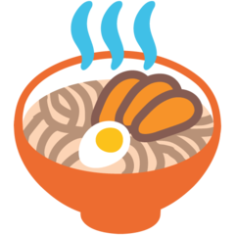



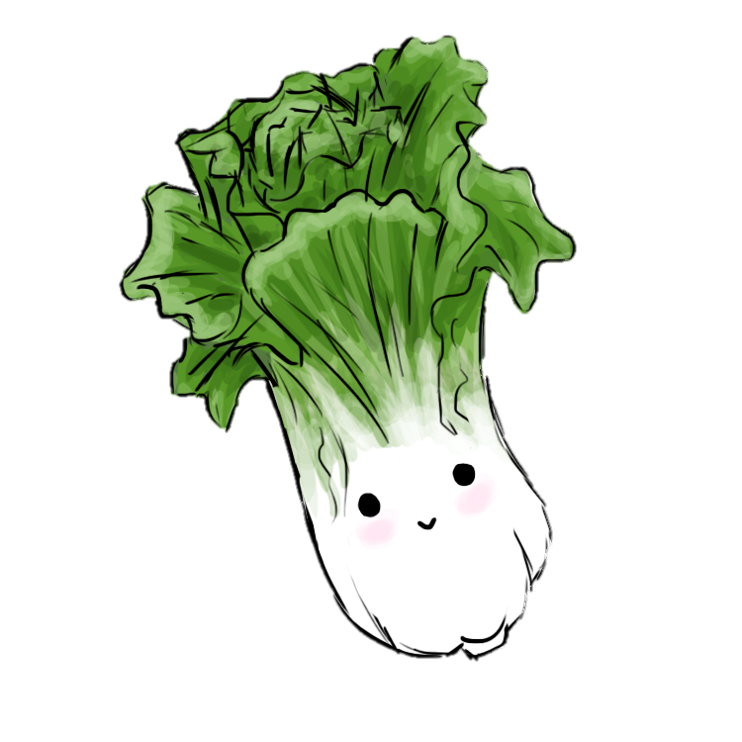

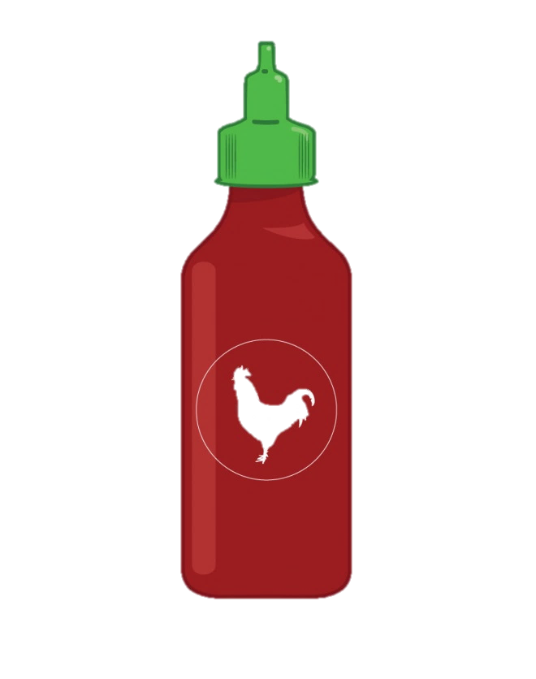



[ɹamən baɹ]
Protein
Apps
gyoza $7.00
dumplings $5.00
edamame $5.00
spring rolls (2) $3.00
egg rolls (2) $3.00
squid balls (Takoyaki) $7.00
Tofu! | Pork!!
Beef!!! | Chicken!!!!
Vegetable!!!!!
Pick Size Half $9.00 Full $12.00
Toppings
egg (Tomagoyaki)
fish cake (Naruto)
mushroom
bean sprouts
kimchi
bok choy
seaweed (Nori)
Pick Broth
Shio
Shoyu
Miso
Tonkatsu
Vegan
Drinks
Soda ($1.50) – Coca-Cola, Diet Coke, Sprite, Minute-Maid Lemonade
Water ($2.00)
Tea ($2.00) – Sencha, Jasmine, Bancha
Spiciness
Levels: mild, medium, hot
Extra Sauces (25c each)
Chili oil
Sriracha
Gyoza sauce
Soy sauce
Our Story
Mama came to Utah in 1947 with one purpose: to create a ramen bar specifically for linguists. Don’t ask why.

